Slide 1
Zooming in and zooming out
Using video to develop a new vision for university teaching
Rossella Santagata

Slide 2
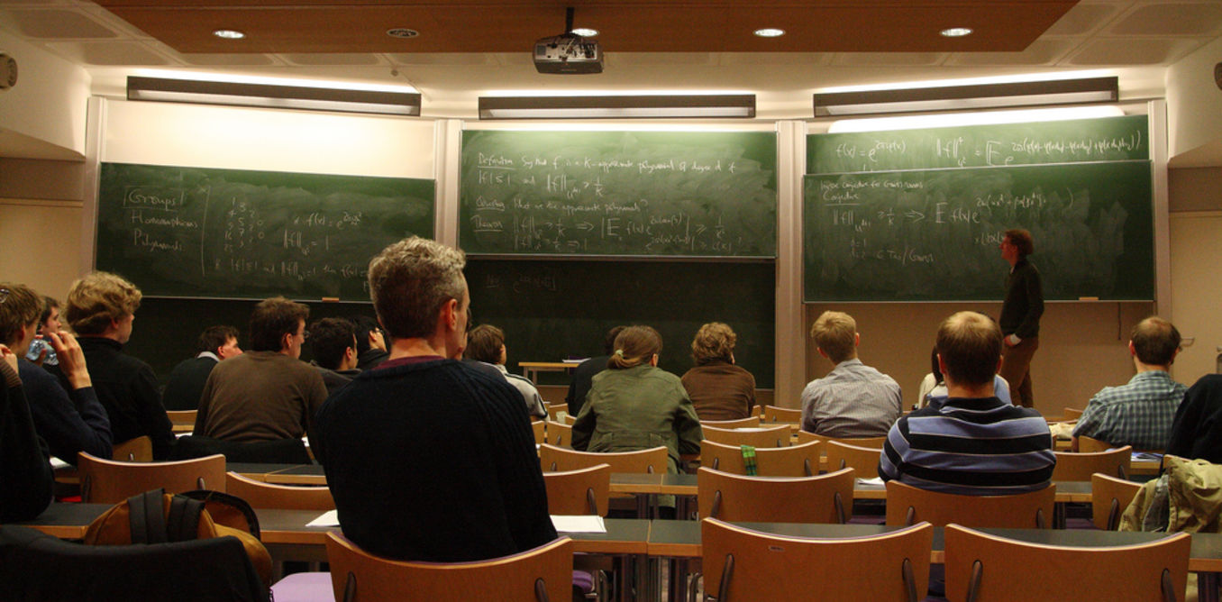
How can we re-envision university teaching?
This Photo by Unknown Author is licensed under CC BY-NC
Notes:
Central question: how do we move from a university classroom where the teacher does most of the talking and students sit quietly to a classroom where students are invited to contribute to the construction of knowledge, learn from each other with the teacher as a facilitator and maybe even utilize technology to support their learning?
Today, I am going to make the argument that using video as a tool driven by a strong theoretical and conceptual framework offers promising directions for introducing changes in university classrooms.

Slide 3
Today
Affordances of video
Importance of strong theoretical framing
Professional vision and noticing as ways to zoom in and out
Research on noticing and video use
New project: Noticing in mathematics university classrooms

Slide 4
Affordances of Video
Slows down the teaching process, allowing viewers to unpack interactions from multiple perspectives
Captures viewpoints and interactions that teachers might not have access to during teaching
Captures materiality and spatiality, movement, relationships between human activity and objects in the classroom
Can be shared and used as a tool for collective discussion and reflection on teaching
Notes:
Many have discussed the affordances of video for changing teaching
Here are a few that I see as particularly important

Slide 5
Video is Just a Tool
“To be an effective tool for teacher learning, video must be viewed with a clear purpose in mind” (Borko et al., 2008, p. 419).
Interpretivist paradigm
Video experiences place the teacher’s personal experience at the center of the observation and may give them more agency in both the selection of clips and the focus of discussions. Through the aspects of the teaching-learning process that observers are able to notice, they are expected to develop competencies and dispositions that will later translate into instructional moves.
Cognitivist paradigm
Video observation activities generally aim to promote teachers’ selective attention and interpretation of students’ thinking. Research “appears to assume a unidirectional relationship between thought and action, implying that training the perception of instruction should by itself enable teachers to enact effective instruction” (p. 103).
Sociocultural paradigm
Provides an ecological approach to using video in teacher education or professional development contexts. These approaches consider in an integrated way the roles and influences of society, institutions, and individuals on teachers’ learning and pay greater attention to the use of videos in the context of schools and collaboration among groups of teachers.
More on video and educational research: https://faculty.sites.uci.edu/videoresearch/
Brouwer (2022)
Notes:
But I and others have also argued that video is jus a tool and we need theoretically driven and structured ways to use video for instructional improvement.
Brouwer (2022) argues that cognitivist, interpretivist, and sociocultural are three major paradigms that guide the study of teacher learning with video.

Slide 6
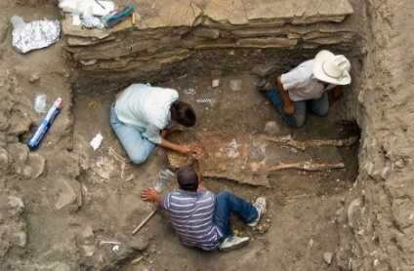
Professional Vision
Goodwin (1994)
“ways of seeing and understanding events that are answerable to the distinctive interests of a particular social group” (p.606)
Seeing as social practice, situated in socio-cultural context
Notes:
Today I’d like to discuss professional vision as a theoretical lens that has ben proven to be very productive in school settings to understand teacher competence and introduce changes in teaching

Slide 7
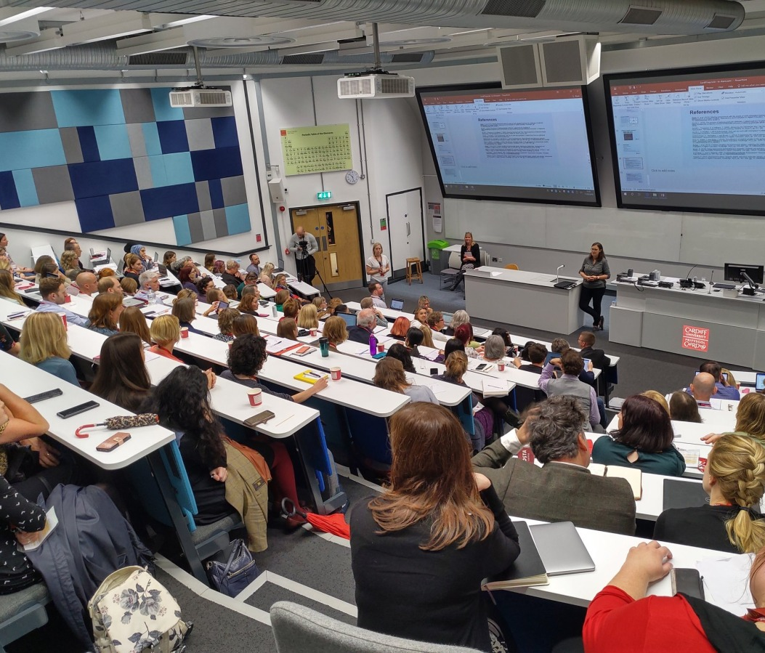
Zooming out
Who are we here to serve? And for what purposes? How do our classrooms serve the equity goals that should be the foundations of a truly democratic university?
How do our history and cultural lenses limit what we see and the opportunities for democratic spaces we might create in our university classrooms?
This Photo by Unknown Author is licensed under CC BY-NC
Notes:
What I find most powerful about the construct of professional vision is that it pushes us to ask questions about the purpose of what we do as teachers in university settings—what we try to achieve in the classroom. Our broader goals, our vision, drive our decisions and what we choose to see. What we highlight about a situation and how we make sense of it.
The opening of borders, the mixing of cultures and ways of being, pushes us to confront the hard questions –who are we here to serve and for what purposes? How do our classrooms serve the equity goals that should be the foundations of a truly democratic university?
How do our history and cultural lenses limit what we see and the opportunities for democratic spaces we might create in our university classrooms?
This vision also drives ways we zoom in ---

Slide 8
Zooming in
Teacher noticing captures what we focus on during the split seconds of classroom activity
Teachers’ beliefs and dispositions toward teaching and learning frame what teachers notice (Ball, 2011; Hand, 2012)
What teachers tend to focus on matters for their teaching quality and student learning (Kersting et al., 2012)
Awareness of one’s noticing can help improve teaching and student learning (Berliner, 2001; Erickson, 2007; Franke et al., 2001; van Es & Sherin, 2008)
Notes:
Most research conducted in classroom settings has centered on what teachers see during teaching, how they make sense of what they see, and how they decide what to do next—this is the construct of teacher noticing

Slide 9
Noticing Facets
Identifying what is relevant in a classroom situation (van Es & Sherin, 2002)
Making connections between what is observed and larger principles of teaching-learning, and using what is known about the context to reason about what occurred (van Es & Sherin, 2002).
Responding/making decisions (Jacobs et al., 2010)
Shaping interactions to obtain information that supports reasoning about the event (van Es & Sherin, 2021)
Notes:
Different authors have highlighted and examined different facets or components of noticing

Slide 10
Framework for Learning to Notice (van Es, 2010)
LEVELS | 1. Baseline | 2. Mixed | 3. Focused | 4. Extended
What teachers notice? | Whole class environment, behavior | Teacher pedagogy | Particular students’ thinking | Particular students’ thinking and relationship between teaching and student thinking
How teachers notice? | General impressions Descriptive and evaluative comments No evidence | Highlights noteworthy events Evaluative with some interpretative Begins to refer to specific events and interactions | Highlights noteworthy events Interpretative comments Elaborates on specific events and interactions | Highlights noteworthy events Interpretative comments Elaborates on specific events and interactions Connections to principles of learning and proposes alternative pedagogical solutions
Notes:
My colleague van Es has introduced an useful framework to guide and measure the development of noticing that draws on existing research.

Slide 11
Unpacking Noticing
Notes:
Give you a flavor of a conversation centered on noticing supported by the use of video
A fourth year K teacher who attended a teacher prep program that highlights the importance of student centered teaching. In these clips she was asked to review excerpts from her first year of teaching and share with me what she noticed.
We can see in action the facets of noticing I have just shared

Slide 12
How Might Video be Used to Support Noticing Competencies? (van Es & Santagata, 2017)
Planning
To learn to attend to the details of student thinking and integrate that knowledge into the lesson plan
To reason about teaching practices and their impact on student learning
Teaching
To slow down the work of teaching
To learn to talk about important elements of teaching
Reflecting
To review teaching moments that went unnoticed during teaching
To develop shared language
To discuss next steps grounded in evidence
Notes:
Beth van Es and I have reflected on the use of video to work on noticing for the purpose of improving different teaching tasks.

Slide 13
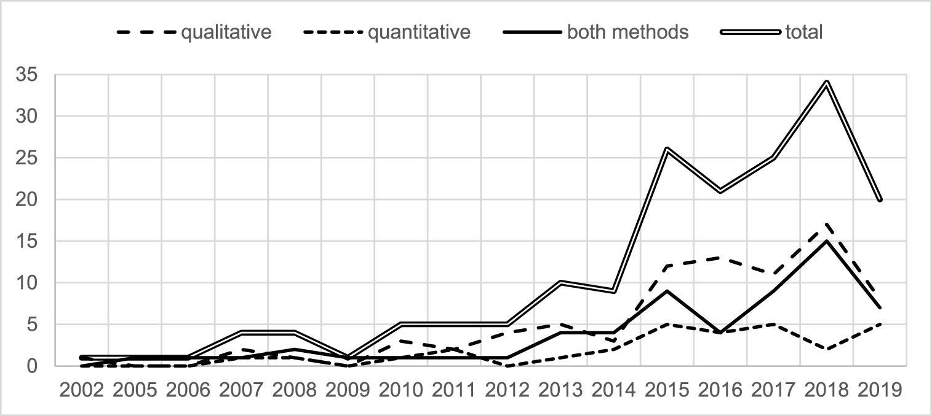
Research on teacher noticing: historical perspective
König, Santagata, Scheiner, Adleff, Yang, & Kaiser (2022). Teacher noticing: A systematic literature review of conceptualizations, research designs, and findings on learning to notice, Educational Research Review, Vol. 36
https://doi.org/10.1016/j.edurev.2022.100453
Notes:
What do we know about noticing?
172 empirical papers
103 (53%) of the authors are from North America, 70 (36%) from Europe, 13 (7%) from Asia, 7 (4%) from Oceania, and 2 (1%) from South America. We did not find any articles authored by scholars from Africa.
empirical research on teacher noticing has proliferated over the past decade, with the majority of studies (i.e., 34 studies) published in 2018. Since our database was created in June 2019, it underestimates the total number of papers published in 2019. Regarding the distribution of studies using the three different research designs, the number of qualitative studies and studies using qualitative and quantitative methods has increased, whereas the number of studies deploying quantitative methods only has not increased since 2015.
Of the 182 papers selected, 135 referred predominantly to the cognitive-psychological perspective of teacher noticing (74%), 35 (20%) referred predominantly to the socio-cultural perspective of teacher noticing, and only 12 (approximately 6%) referred to both perspectives.

Slide 14
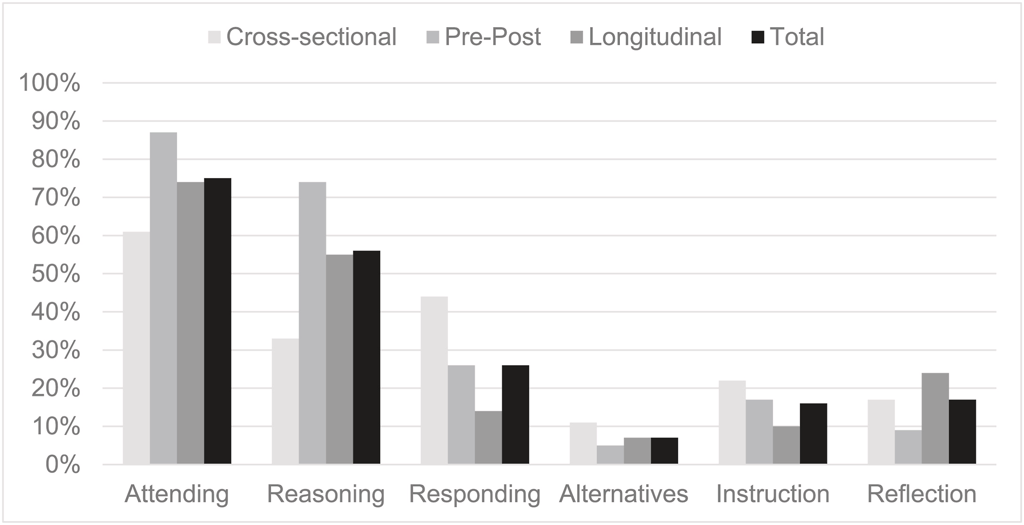
Research on teacher noticing: impact of interventions
König, Santagata, Scheiner, Adleff, Yang, & Kaiser (2022). Teacher noticing: A systematic literature review of conceptualizations, research designs, and findings on learning to notice, Educational Research Review, Vol. 36
https://doi.org/10.1016/j.edurev.2022.100453

Slide 15
Video and learning to notice in mathematics
Video is an effective tool to develop teacher noticing
The cognitive perspective is the most utilized (91% of studies)
Most studies focus on attending (89%) and interpreting (80%) and fewer on responding (37%)
Few studies (17%) examined impact on teaching quality
Only 26% have used a software to guide teacher noticing and only 4 a video annotation software
Missing is design-based implementation research
Santagata, R., et al. (2021). Mathematics teacher learning to notice: A systematic review of studies of video-based programs. ZDM–Mathematics Education, 1-16.
Notes:
Additional notes:
Studies with pre-service teachers that inquired about how an intervention facilitated the development of noticing most frequently employed qualitative approaches (82%, n = 9), while studies with in-service teachers were about evenly split between qualitative and use of both qualitative and quantitative approaches (qualitative: 43%, n = 3; both approaches: 57%; n = 4).
The majority of studies asking about the impact of an intervention (to what extent) involved pre-service teachers (93%, n = 14). For pre-service teachers, these studies drew from a range of empirical approaches, most notably using both methods (57%, n = 8), qualitative (21%, n = 3), and quantitative (21%, n = 3). The one study that investigated the extent to which an intervention influenced in-service teachers’ noticing used a qualitative approach.

Slide 16
Promises and Challenges of Using Video to Develop a New Vision for University Teaching
Promises
Challenges
Build on existing theoretical frameworks and empirical research
Global attention and awareness of importance of high-quality university instruction
Inclusive and diverse university requires a new vision
Culturally and historically ingrained ways of doing university teaching
Competing tasks of university professors

Slide 17
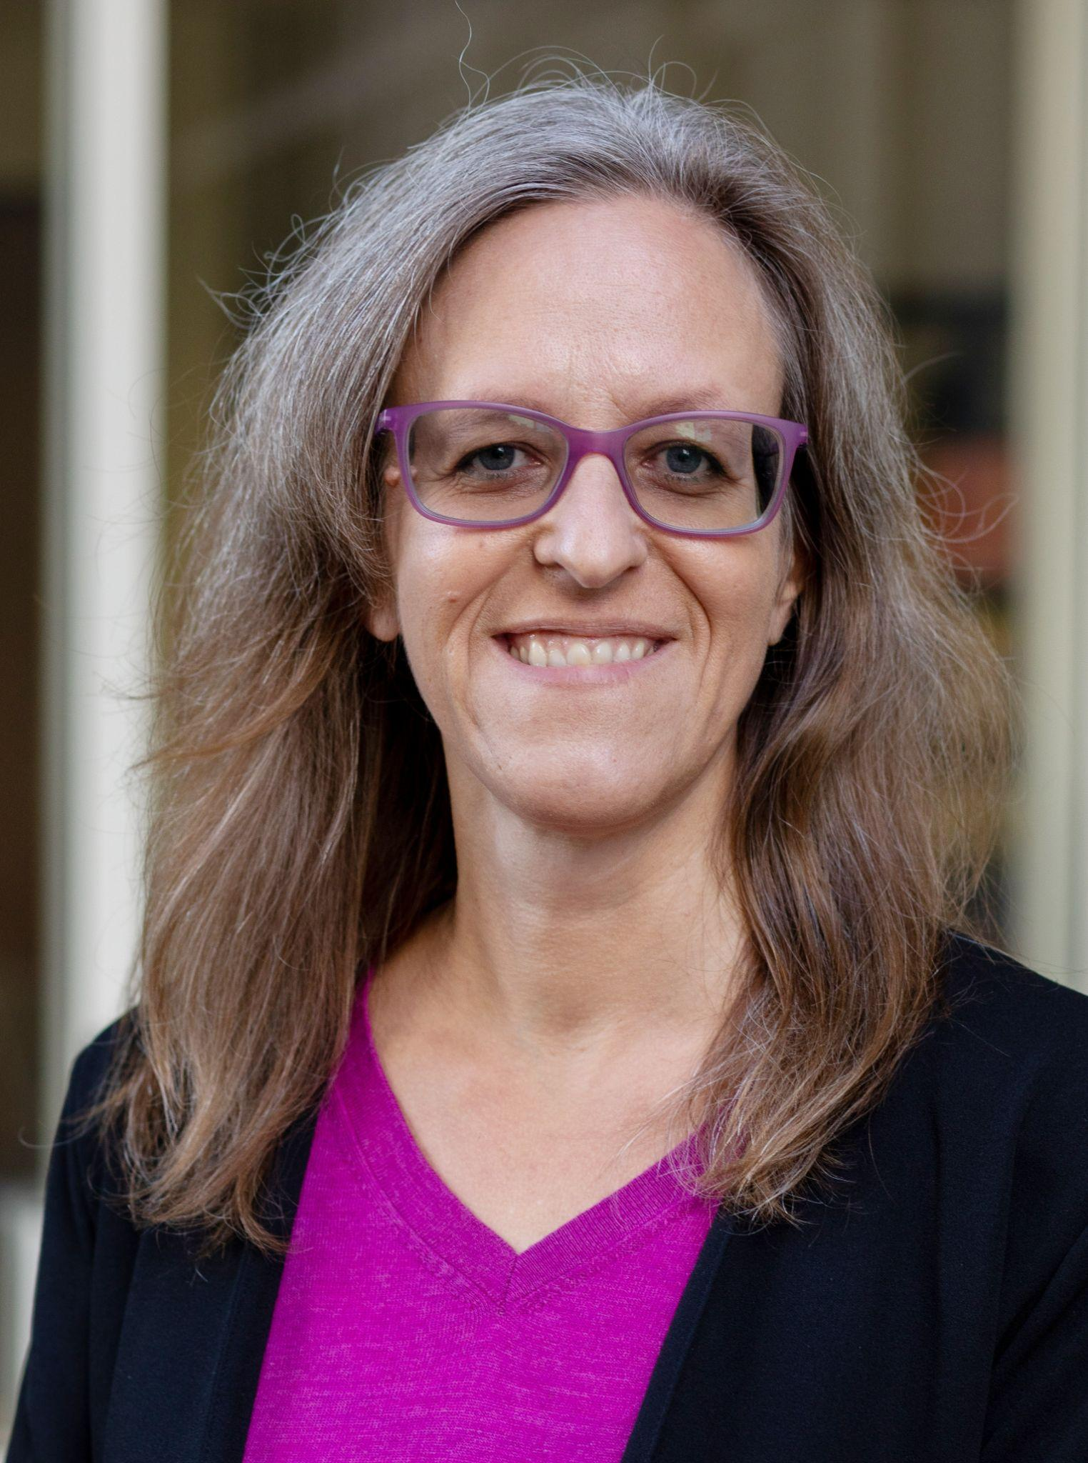
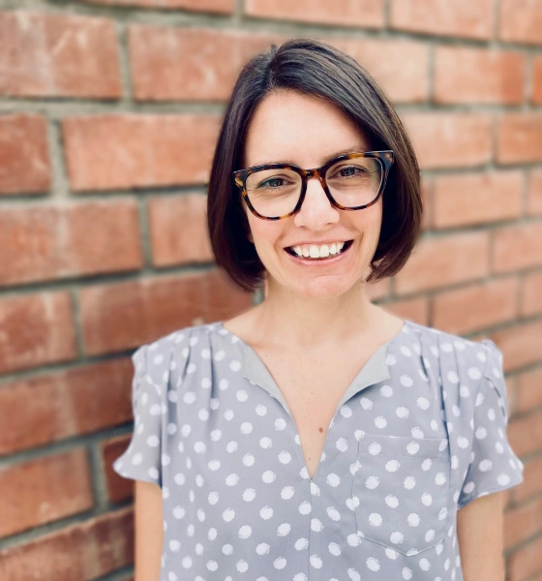
Noticing in Mathematics: A Video-Annotation Curriculum to Enhance Instructors' Understanding of Student Thinking in Proof-Transition Courses
NIMS²: Noticing in Mathematics for Students Success
Co-Principal Investigators
Rossella Santagata
Alessandra Pantano
Roberto Pelayo
Research Team
Patricia Fuentes Acevedo
Victor Arroyo
Christina Kimmerling
Hua Lin
Daniel Morrison

Slide 18
Project Goals
Leverage research evidence about teacher noticing and responsive teaching in K-12 education to design a video-based curriculum that develops noticing competencies and responsive and equitable teaching practices of mathematics instructional teams at the university level
Test this curriculum for efficacy
Instructional teams’ enhanced knowledge of how college students learn proof writing,
Vision for responsive and equitable mathematics teaching,
Enactment of responsive and equitable mathematics instruction,
Enhanced students’ learning
Disseminate the tested curriculum

Slide 19
Research Approach
Partnership between education researchers and faculty/students in mathematics department
Situate noticing professional development
within the history and context of the mathematics department
Utilize design-based implementation research methodology to make explicit and test theory of change

Slide 20
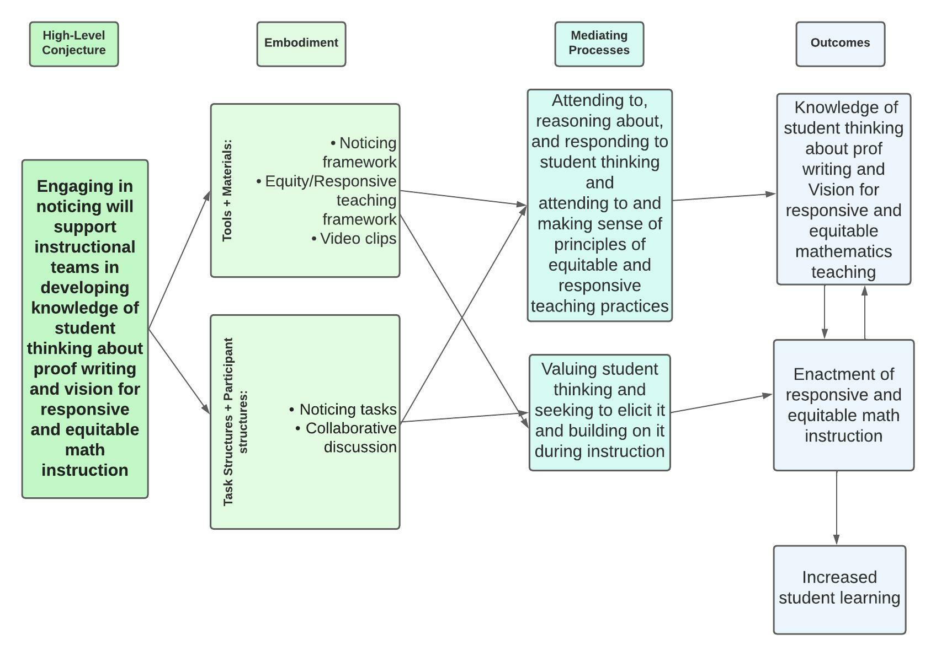
Draft Conjecture Map
Notes:
https://lucid.app/lucidchart/286a5861-f225-4abf-a354-37e9350843ec/edit?invitationId=inv_b01c4537-6f61-40a3-9132-82f3170697d6

Slide 21
Teacher Noticing Conception
The process of constantly attending to and making sense of student mathematical thinking and of the interactions that unfold in the classroom, while also using that information to both learn and inform next steps in teaching (Jacobs, Lamb, & Philipp, 2010).

Slide 22
Sample Noticing Prompts
Student Thinking
What does the student in the video appear to understand mathematically?
What confusions or difficulties does s/he seem to have? From where might these originate?
Where in the video/transcript do you see evidence of student understanding/difficulties?
Design of Mathematics Instruction
How was the task designed to elicit student talk and thinking?
What questions did the instructor ask to make student thinking visible?
How did students engage with the tasks? What did they understand? What was confusing? Where in the video/transcript do you see evidence of student understanding/difficulties?

Slide 23
Sample Noticing Prompts
Features of equitable mathematics instruction
In what ways does each student engage in the work of the class? How can more opportunities be created for every student to participate in meaningful ways?
What opportunities do all students have to see themselves and others as proficient disciplinary thinkers, to grapple with challenges and construct new understandings, to build on others’ ideas, and to demonstrate their understandings?
How can more of these opportunities be created?
Features of responsive teaching
How did the questions asked by the instructor further develop the key mathematical ideas?
How did the instructor monitor student learning throughout the discussion?
What opportunities did the student have to explain their ideas? How did the instructor build on student ideas?

Slide 24
Year 1: Refining the conjecture map

Slide 25
Situating curriculum into specific context
Identify key core concepts in proof writing
Design and collect pre/post student assessment data
Co-constructing vision for teaching and learning in the proof writing course
Video and task design
Video collection
Design of noticing tasks and activities
Iterations of design, testing, and revisions
Classroom settings
Student focus groups

Slide 26
Year 2: Early Implementation Phase
Pilot and collect student pre/post-test data
Test noticing video-based curriculum with two instructional teams
Collect teams’ experience and learning data
Additional adjustments to the curriculum
Year 3: Efficacy Phase
Conduct full test and compare student learning data from prior year

Slide 27
Initial Learnings (Year 1)
Opportunity to attend to and make explicit skill of proof writing, separate from content understanding
Through generating the proof framework, math instructors were able to articulate hidden curriculum of the class. We see this framework as being generative for future instructional teams.
Opportunity to introduce an asset-based lens when viewing student work and thinking
Already have had time to reflect on student work using an asset-based lens (i.e. what do students know?). This led to a rich discussion about knowledge students are bringing to the course. Connections were made to how TAs can/should view student work when grading. Instructors have started to use proof framework as a lens to think about what students know about writing a proof.
Opportunity for true mathematics-education collaboration
Initially we started as an education team and as a mathematics team. We have created two subcommittees of mixed math and ed team members, acknowledging the need for distributed expertise to create project artifacts.

Slide 28
Change as Negotiation of Tensions and Possibilities
Tensions (Zooming out)
Course structure restricts opportunity for student thinking to be made visible
TAs have limited time or opportunity to learn new practices, create new material, and are often tasked with re-teaching lecture material
Institutional structures (such as staffing) and visions about teaching/learning might limit the impact of the project beyond the project team
Future possible learning (Zooming in)
Opportunity to see deep engagement with tasks as worthy of class time spent
Opportunity to make use of classroom participation structures to increase engagement for all students, to see classroom discourse as marker of equitable instruction

Slide 29
To Summarize
Research in school settings provides evidence that video is an effective tool to engage teachers in the study of the teaching-learning process
Some evidence that video analysis promotes changes in instruction
Professional vision and noticing frameworks offer productive lenses for working with video
Video analysis as promoting discussions about our vision for university teaching

Slide 30
Grazie!
Rossella Santagata
School of Education, UC Irvine
Email: r.santagata@uci.edu
Center for Research on Teacher Development and Professional Practice: https://crt.education.uci.edu/
More on video and educational research: https://faculty.sites.uci.edu/videoresearch/

